Slide 1

Copyright © 2005 – 2006 MES-English.com

Slide 2

Actor

Slide 3

Actress

Slide 4
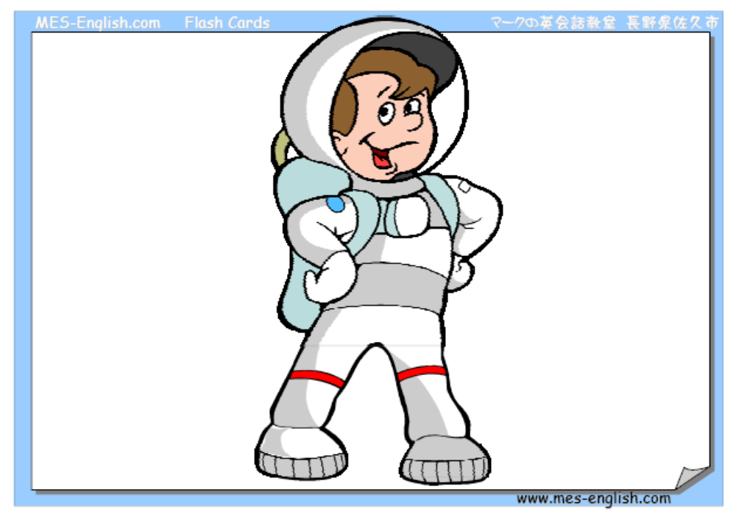
Astronaut

Slide 5

Carpenter

Slide 6

Cashier

Slide 7

Construction worker

Slide 8

Dentist

Slide 9

Engineer

Slide 10

Plumber

Slide 11

Reporter

Slide 12

Secretary

Slide 13
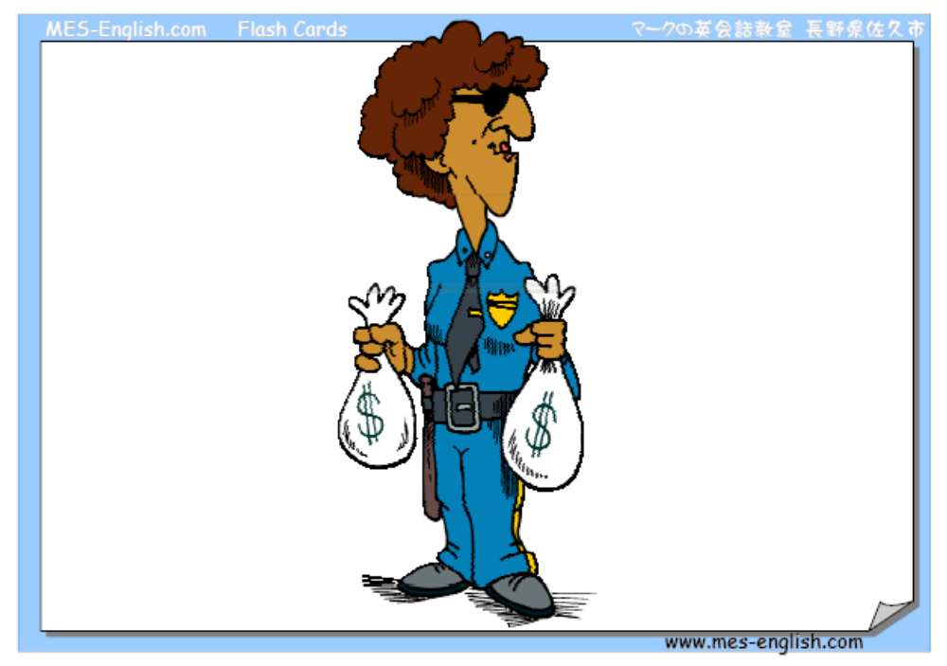
Security guard

Slide 14

Soldier

Slide 15

Veterinarian (Vet)

Slide 16

Waitress

Slide 17

Optician (Eye doctor)

Slide 18

Dancer

Slide 19

Farmer

